Slide 1

CHAPTER 4
Sample Designs
DISCOVER . LEARN . EMPOWER

Slide 2
INDEX
Data Collection and analysis
Collection of Primary data and secondary data
Data Processing and Analysis strategies

Slide 3
Data Collection
The task of data collection begins after a research problem has been defined and research design/ plan chalked out.
While deciding about the method of data collection to be used for the study, the researcher should keep in mind two types of data viz., primary and secondary.
The primary data are those which are collected afresh and for the first time, and thus happen to be original in character.
The secondary data, on the other hand, are those which have already been collected by someone else and which have already been passed through the statistical process.

Slide 4
Collection of Primary data
There are several methods of collecting primary data, particularly in surveys and descriptive researches.
Important ones are:
(i) observation method,
(ii) interview method,
(iii) through questionnaires
(iv) through schedules, and
(v) other methods which include : (a) warranty cards; (b) distributor audits; (c) pantry audits; (d) consumer panels; (e) using mechanical devices; (f) through projective techniques; (g) depth interviews, and content analysis. We briefly take up each method separately.

Slide 5
Collection of secondary data
Secondary data means data that are already available i.e., they refer to the data which have already been collected and analysed by someone else.
When the researcher utilises secondary data, then he has to look into various sources from where he can obtain them.

Slide 6
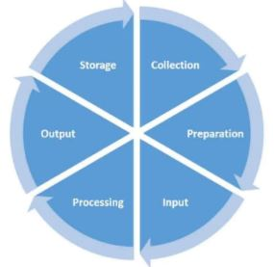
Data Processing
Data processing is the method of collecting raw data and translating it into usable information. It is usually performed in a step-by-step process by a team of data scientists and data engineers in an organization.

Slide 7
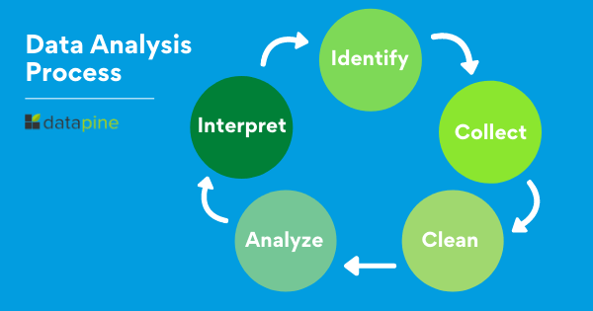
Analysis strategies
Data analysis is the process of collecting, modeling, and analyzing data using various statistical and logical methods and techniques.
Businesses rely on analytics processes and tools to extract insights that support strategic and operational decision-making.

